Slide 1

OPTIMAL SYNCHRONIZATION OF INVERTED PENDULUM USING PID AND LQR
DONE BY:
YOGEESHWAR S – 18EC1343
VISHWATH KUMAR B S – 18BEC1289

Slide 2
AIM & TOOLS REQUIRED
To design various controllers for stabilizing the unstable inverted pendulum and compare the results between them.
P
PI
PD
PID
LQR
TOOLS REQUIRED:
MATLAB
SIMULINK

Slide 3
APPROACH
PID BASED CONTROLLERS:
A proportional–integral–derivative controller (PID controller or three-term controller) is a control loop mechanism employing feedback that is widely used in industrial control systems and a variety of other applications requiring continuously modulated control.
LQR BASED CONTROLLERS:
The theory of optimal control is concerned with operating a dynamic system at minimum cost. The case where the system dynamics are described by a set of linear differential equations and the cost is described by a quadratic function is called the LQ problem. One of the main results in the theory is that the solution is provided by the linear–quadratic regulator (LQR), a feedback controller whose equations are given below. The LQR is an important part of the solution to the LQG (linear–quadratic–Gaussian) problem. Like the LQR problem itself, the LQG problem is one of the most fundamental problems in control theory.

Slide 4
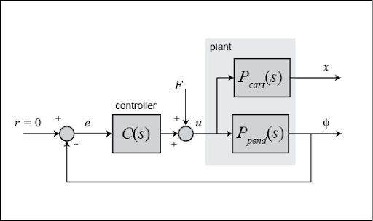
BLOCK DIAGRAM [USING PID]

Slide 5
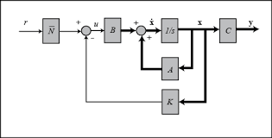
BLOCK DIAGRAM [USING LQR]

Slide 6
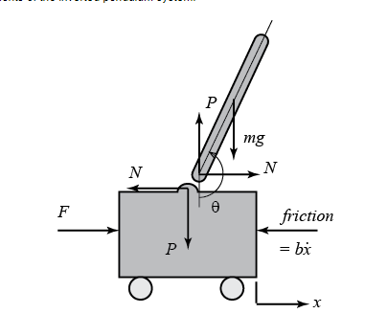


EQUATIONS

Slide 7
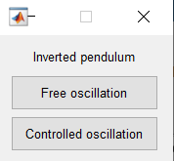
Modes:

Slide 8
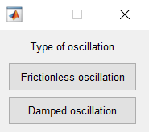
Free Oscillation:

Slide 9
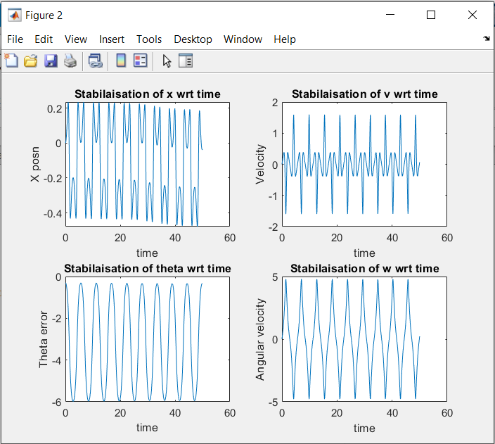
Free Oscillation:

Slide 10
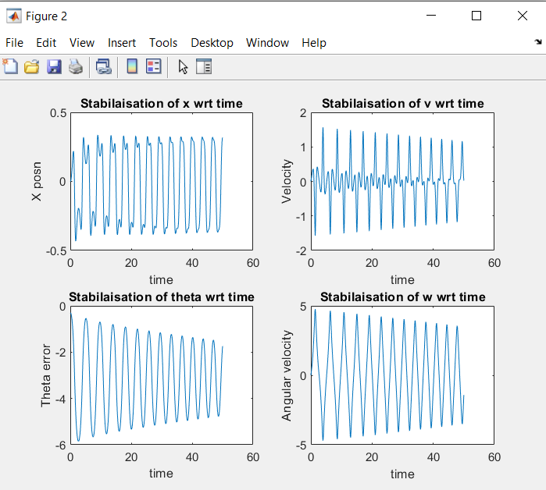
Damped Oscillation:

Slide 11
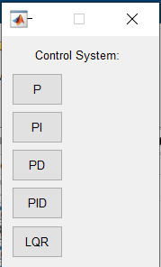
Controlled Oscillation:

Slide 12
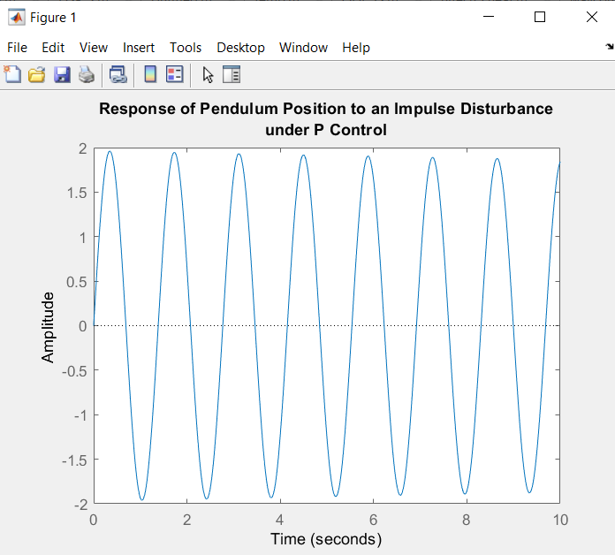
P Controller:
Optimal values:
Kp = 45

Slide 13
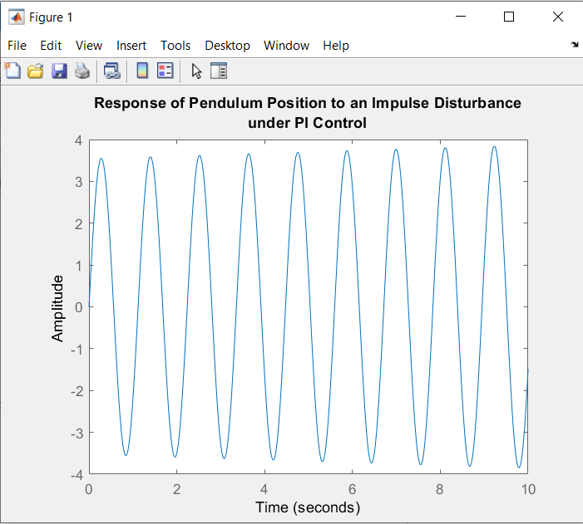
PI Controller:
Optimal Values:
Kp = 100
Ki = 5

Slide 14
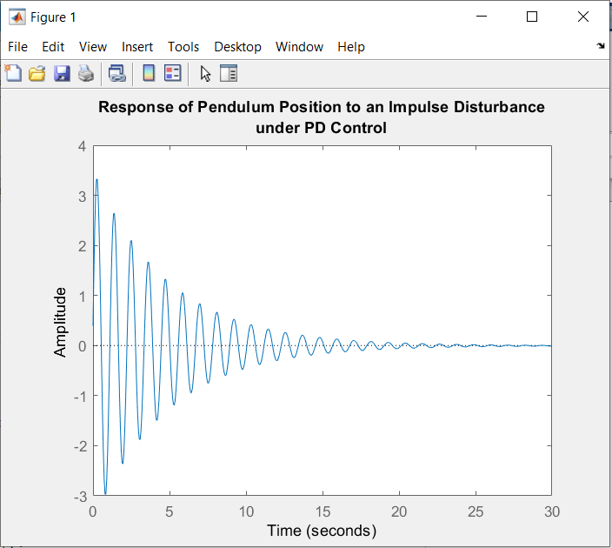
PD Controller:
Optimal Values:
Kp = 100
Kd = 2

Slide 15
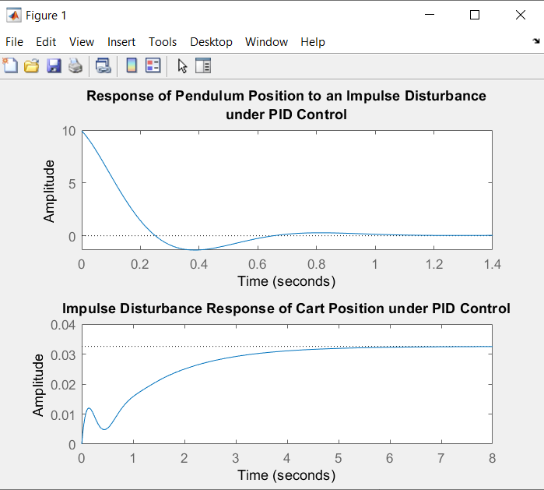
PID Controller:
Optimal Values:
Kp = 350
Ki = 300
Kd = 50

Slide 16
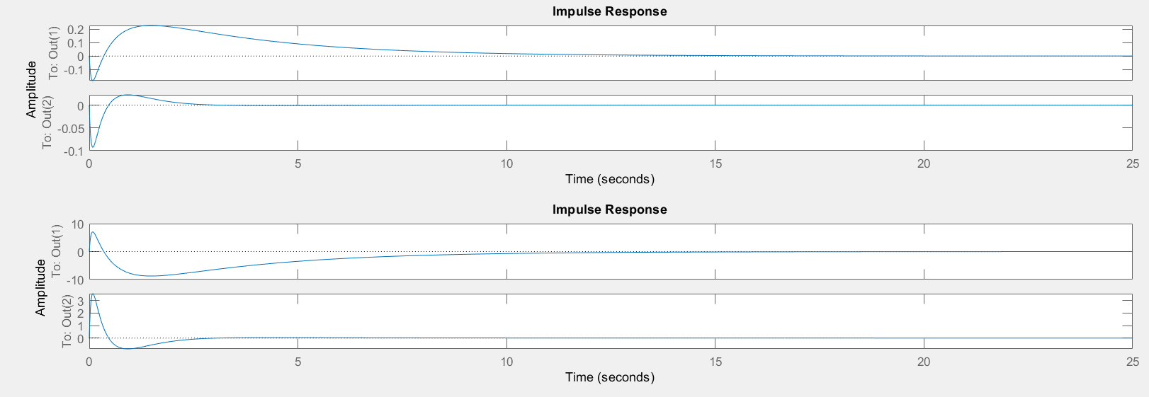
LQR Controller:

Slide 17
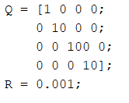
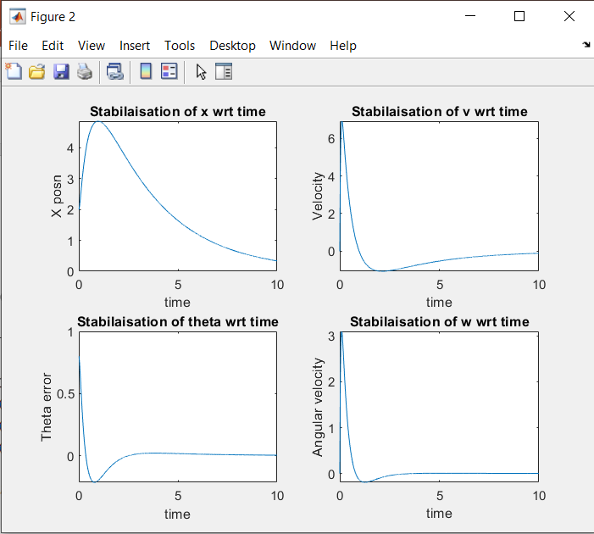
Manual Disturbance [LQR]

Slide 18
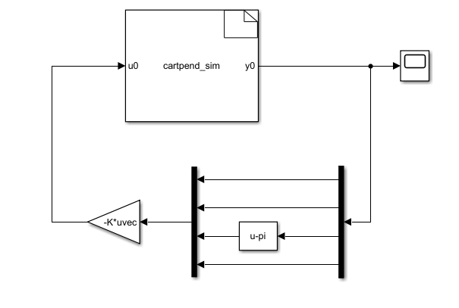
SIMULINK DESIGN [LQR]

Slide 19
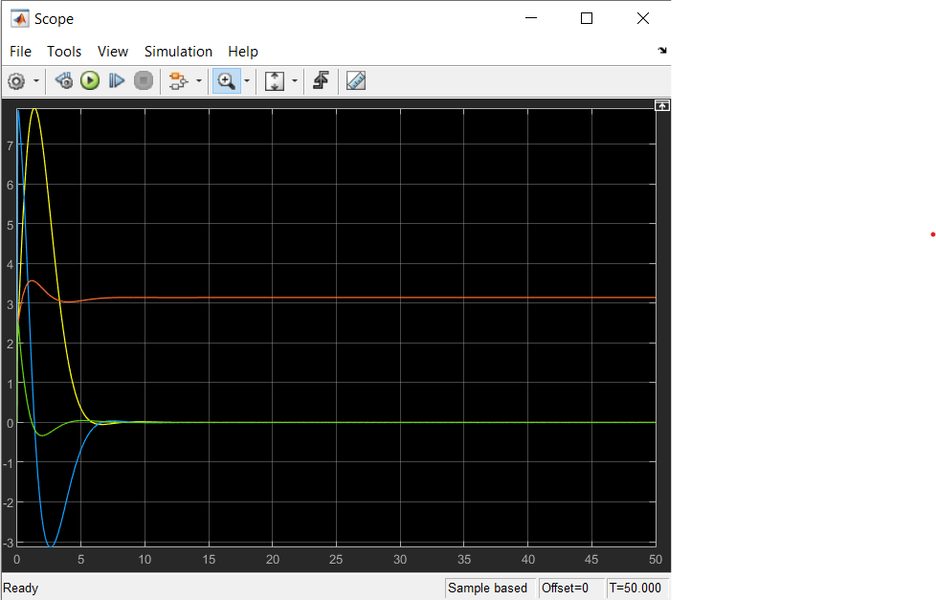
SIMULINK OUTPUT [LQR]
Yellow – Position of the cart
Blue – Velocity of the cart
Red – Angle of the pendulum
Green – Angular Velocity of bob

